Slide 1

The Importance of Sustainable Parent Associations
ECHA 2025

Slide 2
Agenda
Introductions
Definitions
Grandparents Project
Background on Sustainability
The Family Journey

Slide 3
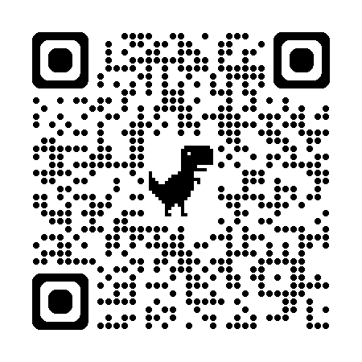
Empowering Families with High Ability Children
https://echafamilies.com/
Parents and caregivers play a crucial role in fostering the well-being of gifted children. Empowering Families with High Ability Children aims to create a platform for collaboration, information sharing, and mutual support. By bringing together parents, caregivers, educators, counselors, and experts from various European countries, Empowering Families with High Ability Children can collectively enhance our understanding and address the unique challenges faced by parents in raising gifted children.

Slide 4




Who are we?
Jessica Potts (jpotts@davidsononline.org) – Davidson Academy Online
Georgia Tsoulfa (gtsoulfa@anatolia.edu.gr) – Center for Talented Youth Greece, Anatolia College
Leonieke Boogaard (leoniekeboogaard@gmail.com) -
Koepel Hoogbegaafdheid
Natalie Jensen (natalie.jensen@potentialplusuk.org) - Potential Plus UK

Slide 5

Role of Parent Associations
Major advocates for the rights and needs of gifted children
Instrumental in identification practices, especially for underrepresented populations
Advocacy work requires years of effort, hence the need for sustainable practices.

Slide 6
Defining Sustainability
Organizational Sustainability
Programmatic Sustainability
Community Sustainability
For parent associations, sustainability is the long-term capacity of the organization to effectively support gifted students, their families, and the broader gifted community.

Slide 7
Importance of Sustainability
Longevity of the association
Institutional knowledge
Keeps communicative effective and relevant
Prioritizes the mental health of members
Ensures adaptability

Slide 8
Common Sustainability Issues
Straying from the original mission
Parents “aging out”
Burnout
Inability to communicate effectively
No central information hub
No/low budget
Lack of flexibility or adaptability
Notes:
Straying from the initial mission of the organization
Parents “aging out” when their children graduate
Lack of time/energy in general, burnout
Inability to communicate in ways/on platforms that reach the intended audiences
From educators’ perspective: needing to share the same info, make the same cases with incoming family cohorts
From parents’ perspective: repeatedly hearing “no” from a school
No budget
Lack of flexibility or adaptability

Slide 9

Building Sustainability via Extended Family
Grandparents Project in the Netherlands
Notes:
Attention to giftedness in the Netherlands started in the 1980s
First parents’ association: Pharos in 1986
Establishment of the Center for Giftedness Research at the Radboud University Nijmegen by Professor Mönks in 1988
First generation of grandparents who may have heard of/had experience with giftedness when their own children were young
May have had bad experiences with school because schools did not have much knowledge about giftedness in the 80s and 90s

Slide 10
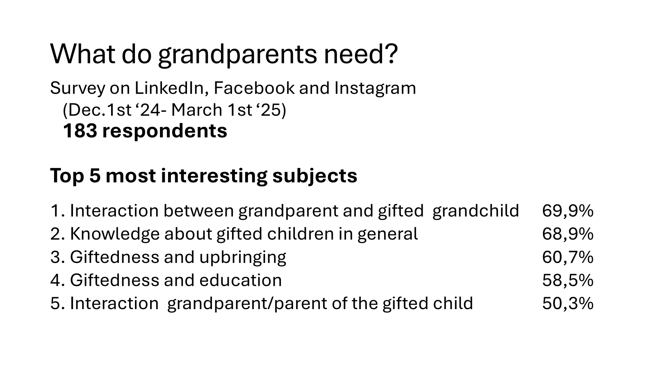

Slide 11
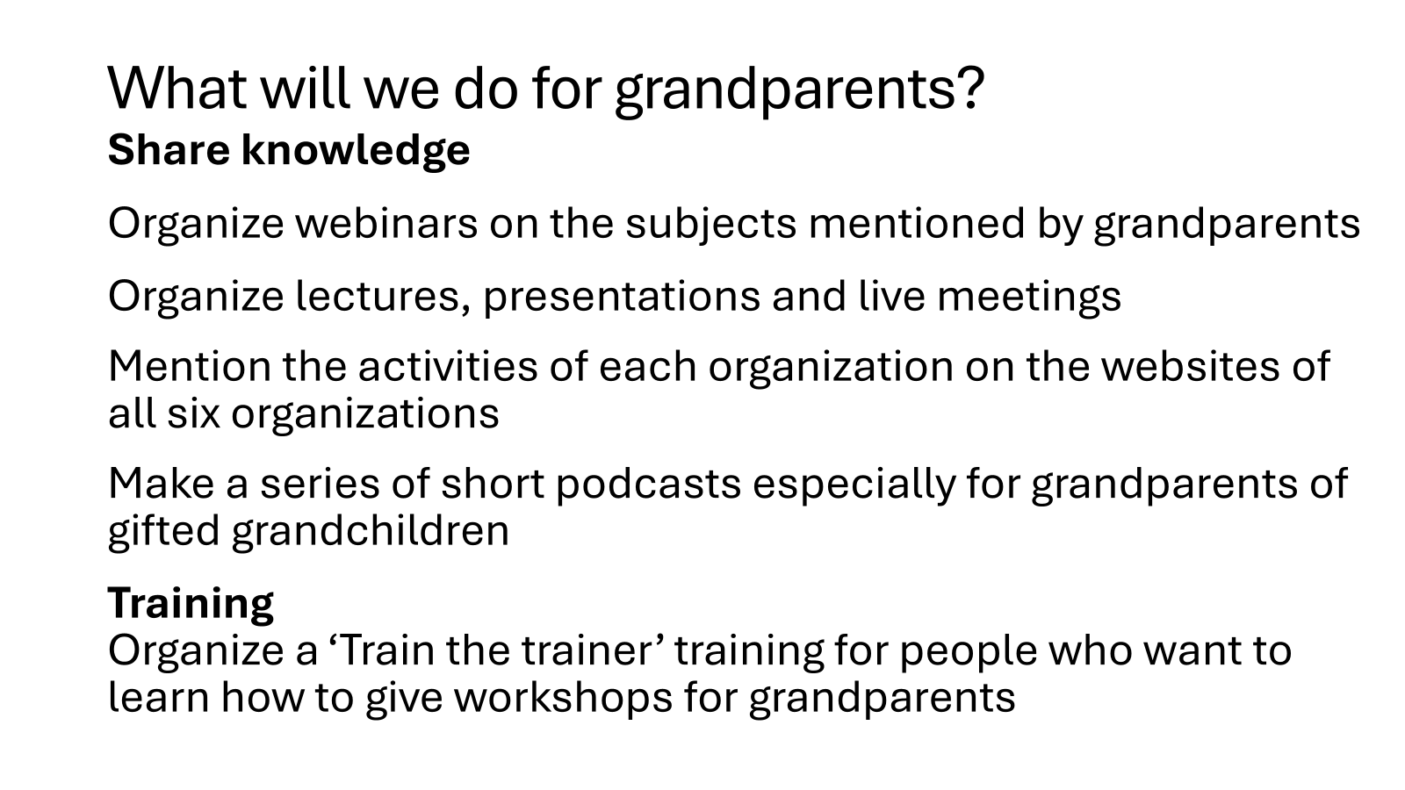

Slide 12
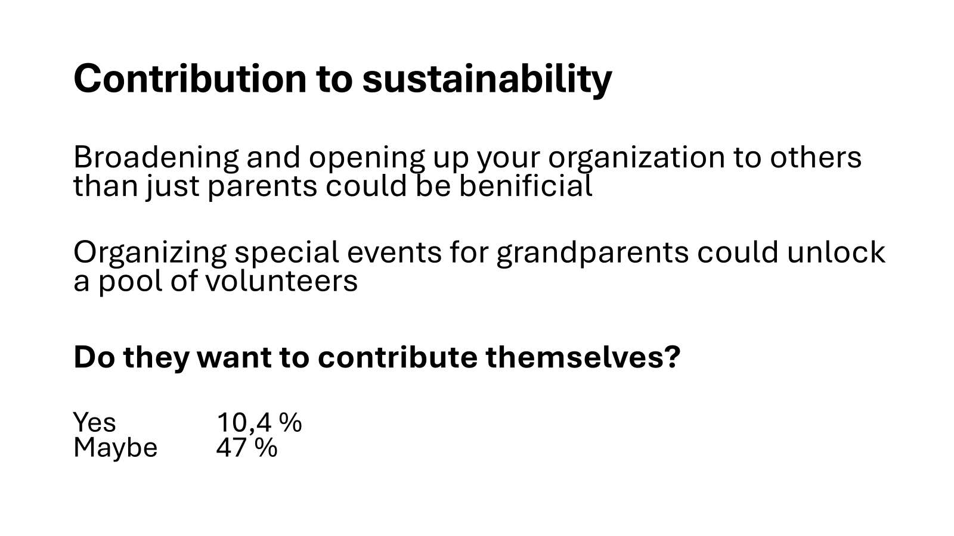

Slide 13

Potential Plus UK & The Family Journey

Slide 14
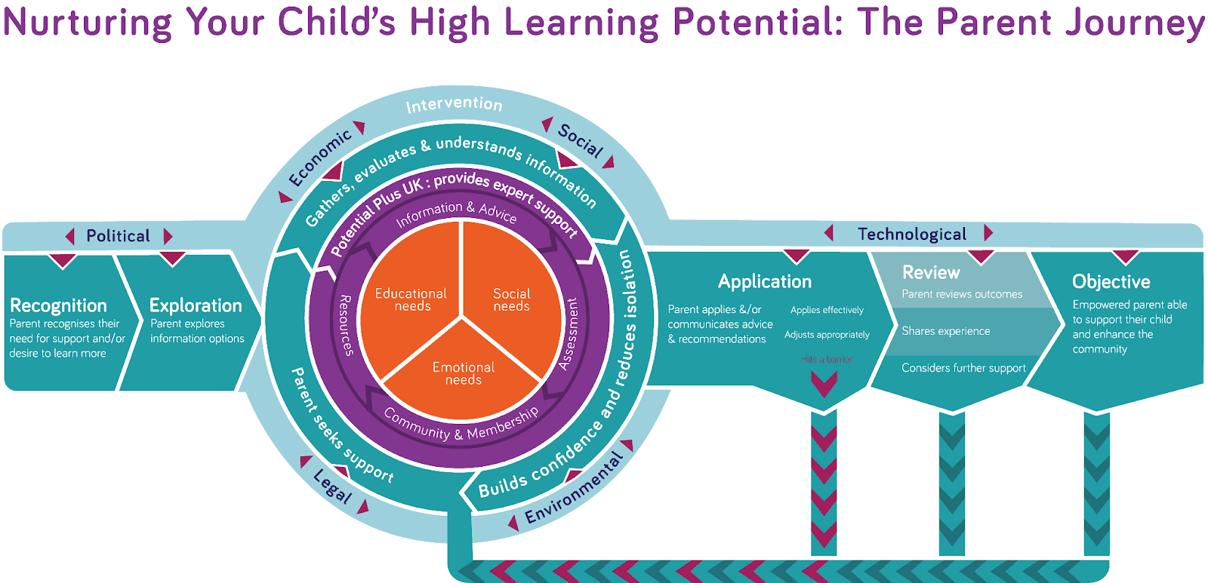

Slide 15
Embedding Sustainability in the Parent Journey Model
Sustainability as a guiding principle, not an add-on, means long term impact, community resilience, and collective growth.
Recognition and Exploration
Clear referral pathways
Cross-organizational cooperation
Intervention and Application
Diverse funding streams
Training and retention
Reflection and Leadership
Alumni networks and leadership pathways
Resource and network tools
Strong online presence
Engagement in leadership, mentoring, and advocacy
Systems for succession and financial resilience

Slide 16

Thank you!
https://echafamilies.com/
jpotts@davidsononline.org
Visit our poster!

